Slide 1
DEFINE AND EXPLAIN HOW ANATOMY AND PHYSIOLOGY ARE RELATED
Anatomy-study of how the body is put together STRUCTURE Physiology-study of how the body works FUNCTION

Slide 2
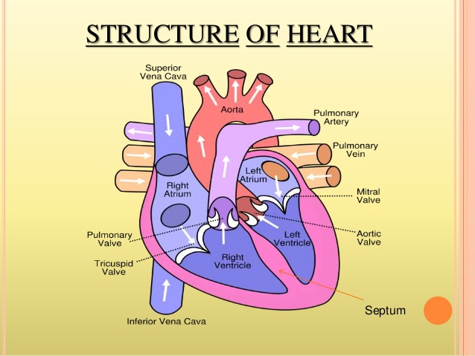
Together anatomy and physiology form the basis of all medical practice.
Body structure = Anatomy Body function=physiology
https://www.youtube.com/watch?v=vZNa_I4xBnk

Slide 3
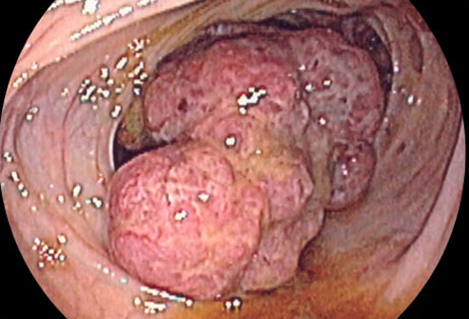
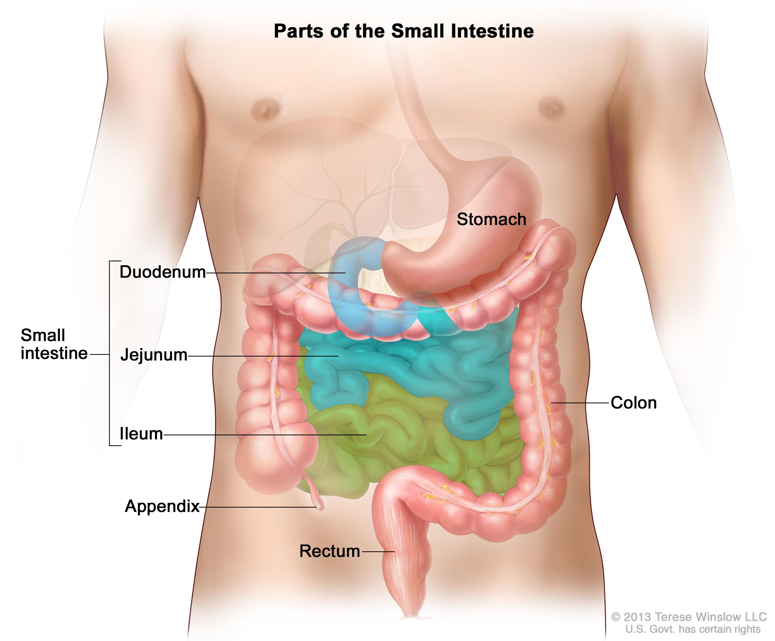
IF structure is altered the body won’t function properly
Example tumor blocking the colon

Slide 4
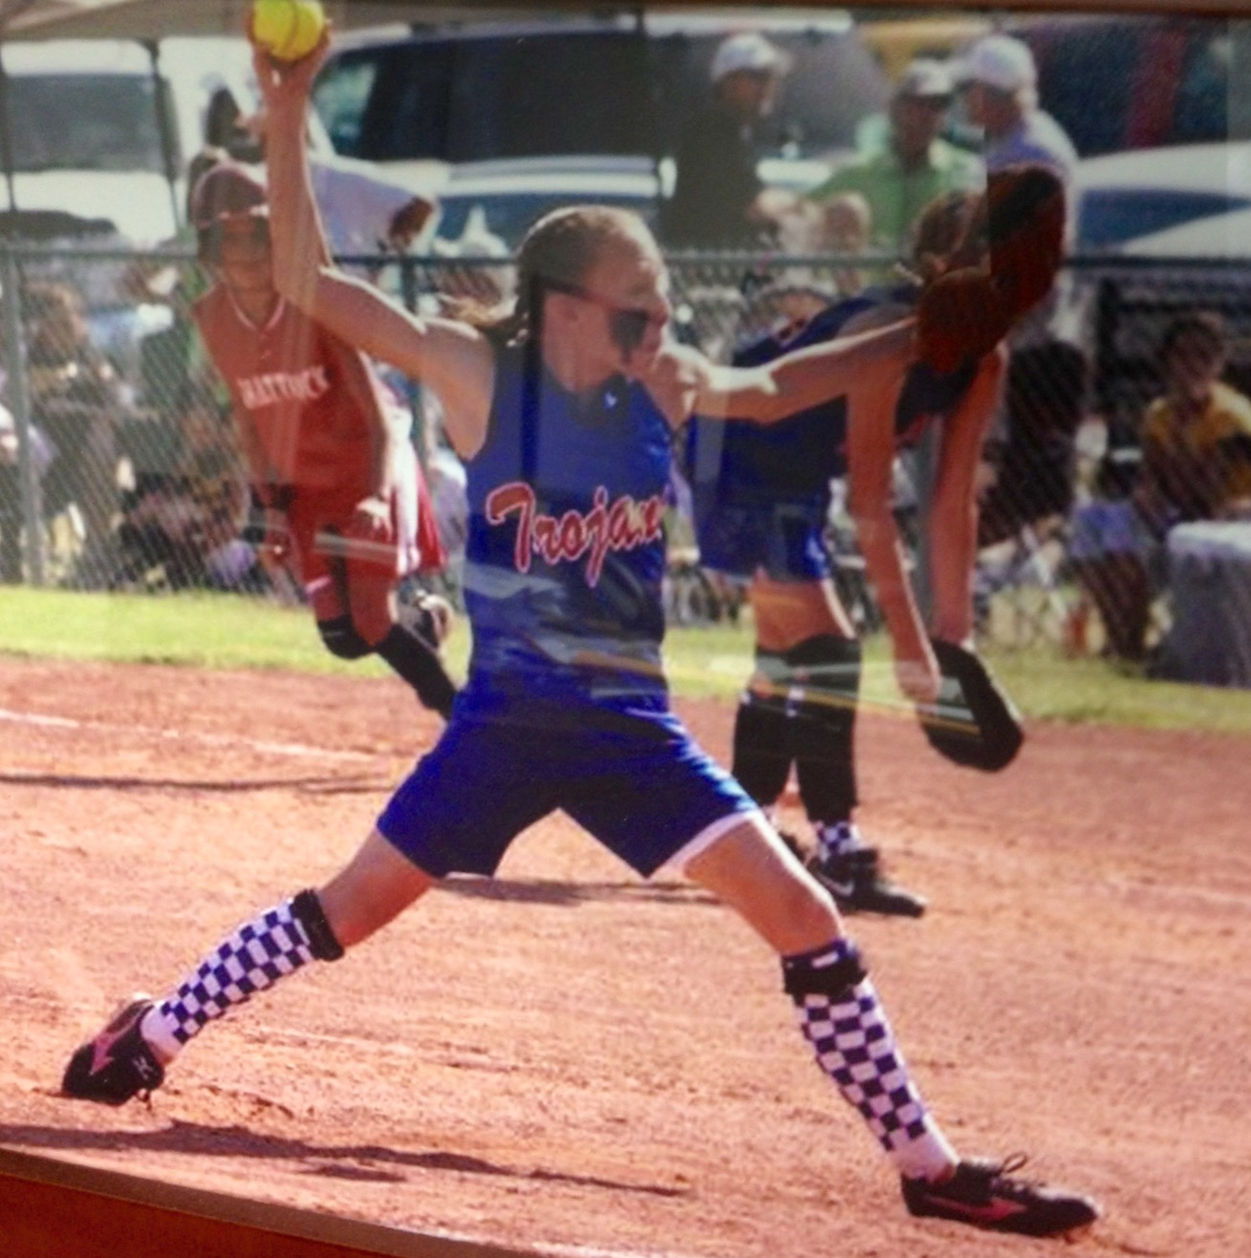
Structure determined function
Example ball and
socket joint
at the shoulder
allows the
body to pitch
a soft ball

Slide 5
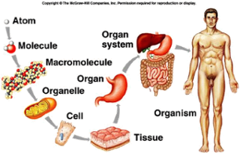
Name and explain the relationship between levels of structural organization that make up the human body.
The body is made up of system that all work together to make the whole organism
A system is a set of interacting or interdependent components forming an integrated whole
Each body system has its own individual parts that are complex to simple in structure SIMPLE
atom
molecule
organelles
cells
tissue
Organs
organ system
organism
COMPLEX

Slide 6
Integumentary system
Covers and protects
Skin, hair, nails, oil and
sweat glands
Common Pathophysiology
Cancer
Burns
Specialist
Dermatologist

Slide 7
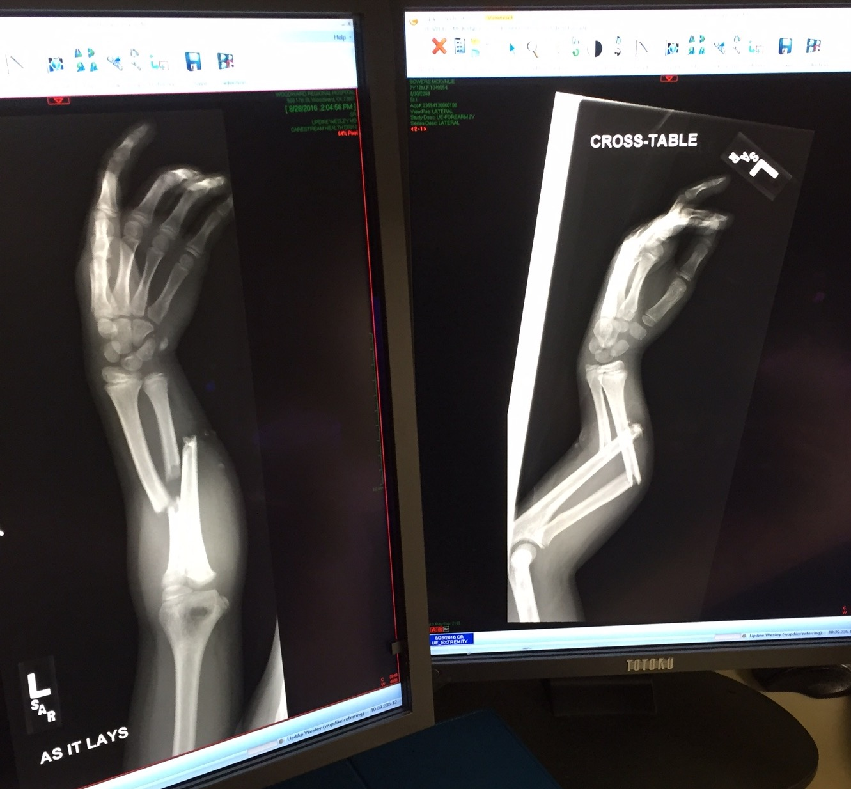
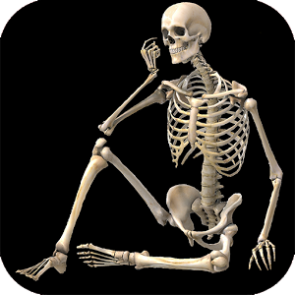
Skeletal system
Framework of the body
Support
Movement
Common Pathophysiology
Fractures
Osteoporosis
Arthritis
specialist
orthopedic surgeons
physical therapist

Slide 8
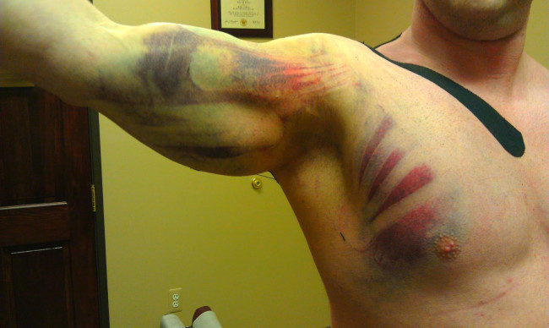
Muscular system
Movement
Body heat
Common pathophysiology
MD
Injury
Strains
Specialist
Athletic Trainers
Occupational therapist
Physical therapist
Speech pathologist

Slide 9
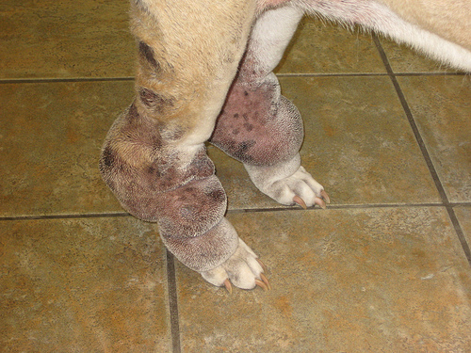
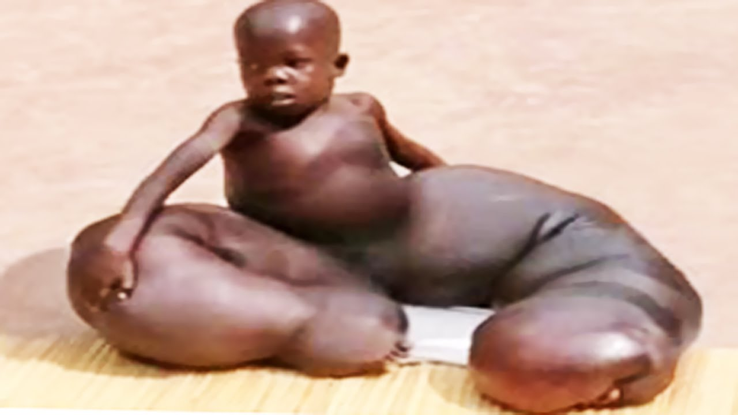
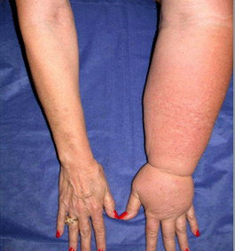
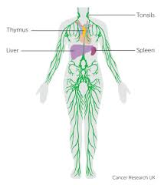
Lymphatic system
Lymph vessels, lymph nodes
Drain and filter fluids
Defense mechanism
Pathophysiology
Elephantitis
Lymphedema
Cancer
Specialist
oncology

Slide 10
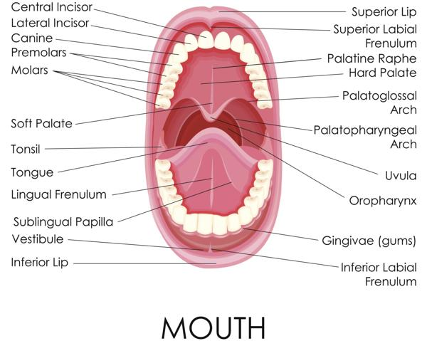
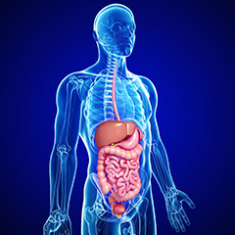
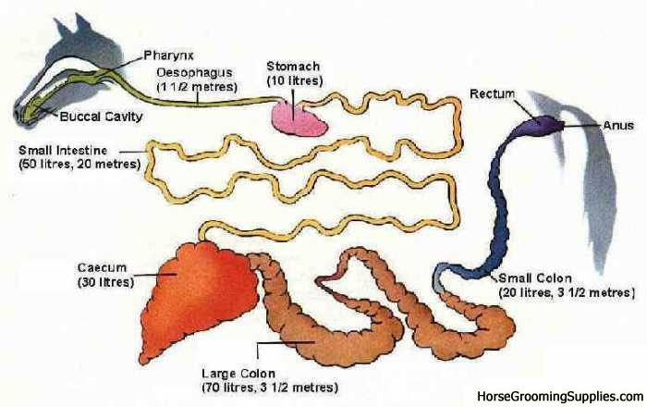
Digestive System
Nutrition
Energy
Building blocks
Cellular metabolism
Elimination
Pathophysiology
Ulcers
Gallstones
Constipation
Specialist-Gastroenterologist
Horse mouth to anus 100 feet 33 yards
Man mouth to anus 30 feet 10 yards

Slide 11
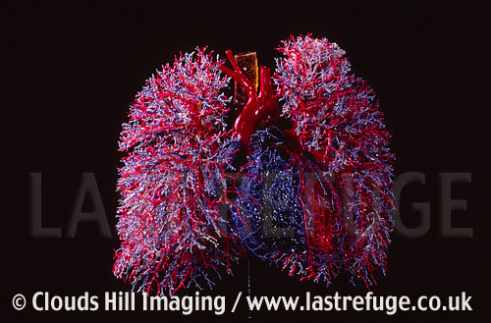
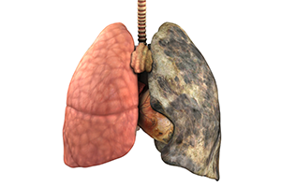
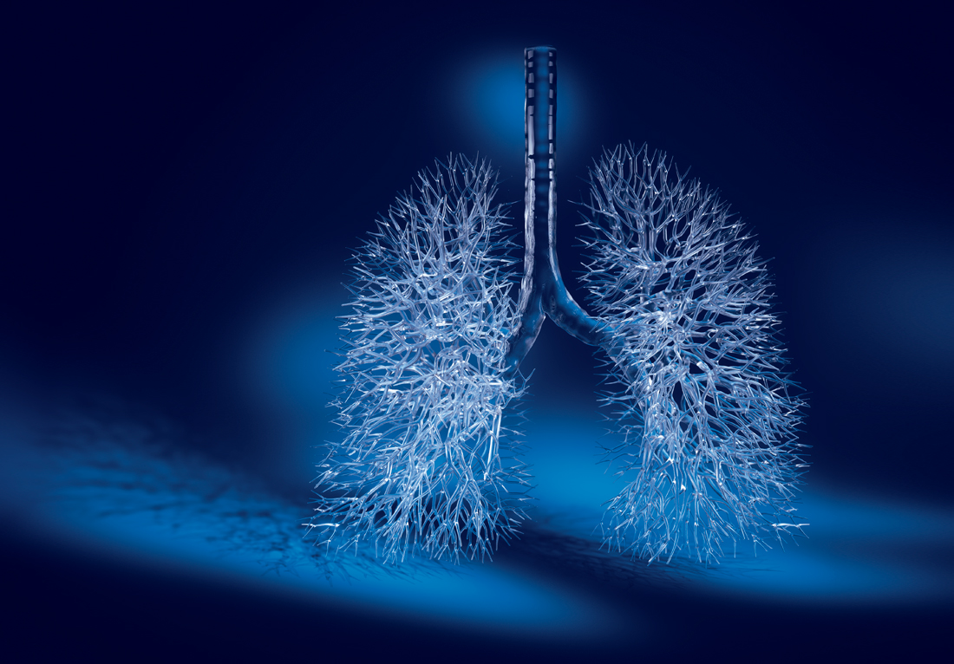
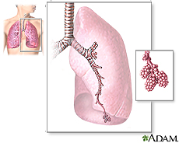
Respiratory system
Air exchange
Pathophysiology
COPD
Cancer
Asthma
Specialist
Pulmonologist
Respiratory therapist
300 million alveoli

Slide 12
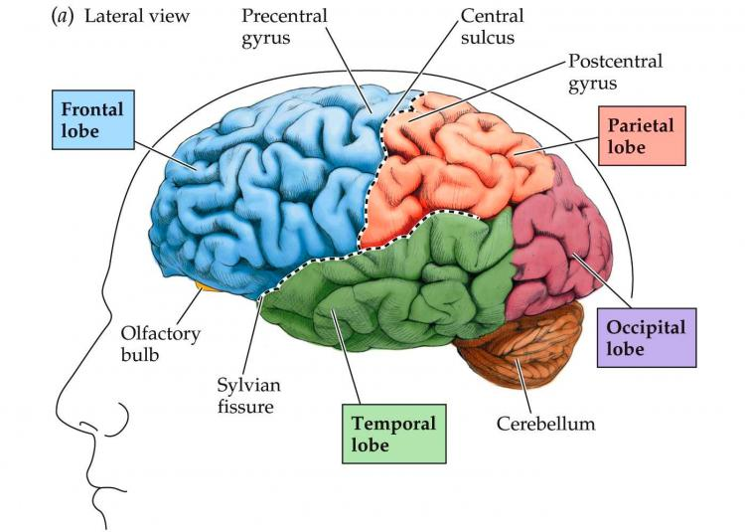
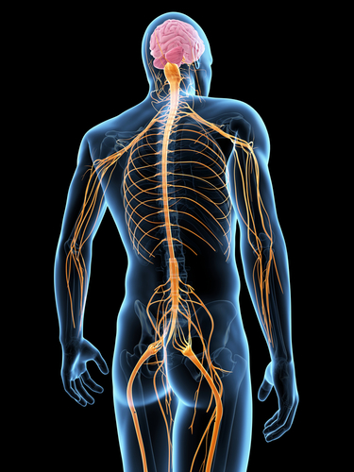
Nervous system
Voluntary and involuntary control
Thinking, planning, reasoning, doing
Pathophysiology
Stroke
Spinal cord injury
ALS
Specialist
Neurologist

Slide 13
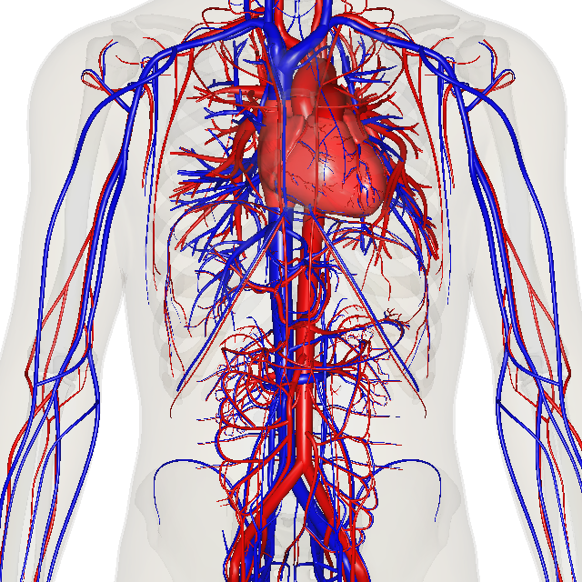
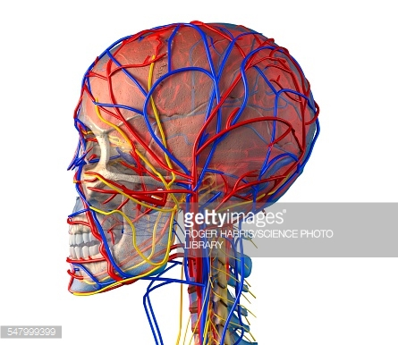
Circulatory System
Transports blood components,
hormones, nutrients, O2 and waist
Pathophysiology
MI
CHF
CAD
Specialist
Cardiologist
Respiratory therapist

Slide 14
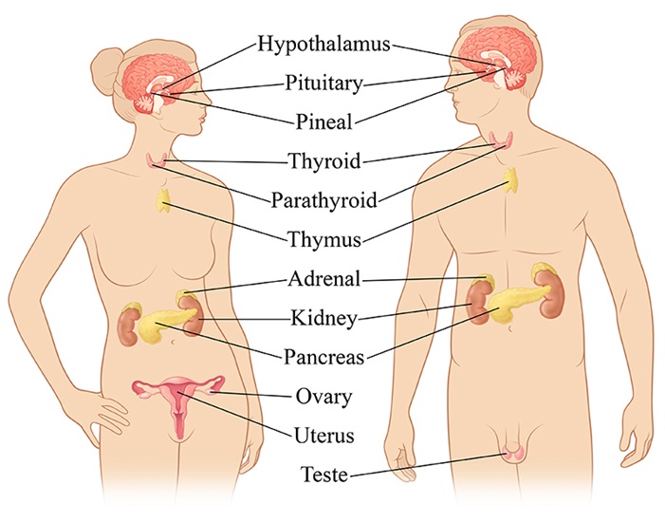
Endocrine system
Produces hormones
Regulate many body activities
https://www.youtube.com/watch?v=eWHH9je2zG4
Pathophysiology
diabetes
thyroid imbalances
specialist
Endocrinologists

Slide 15
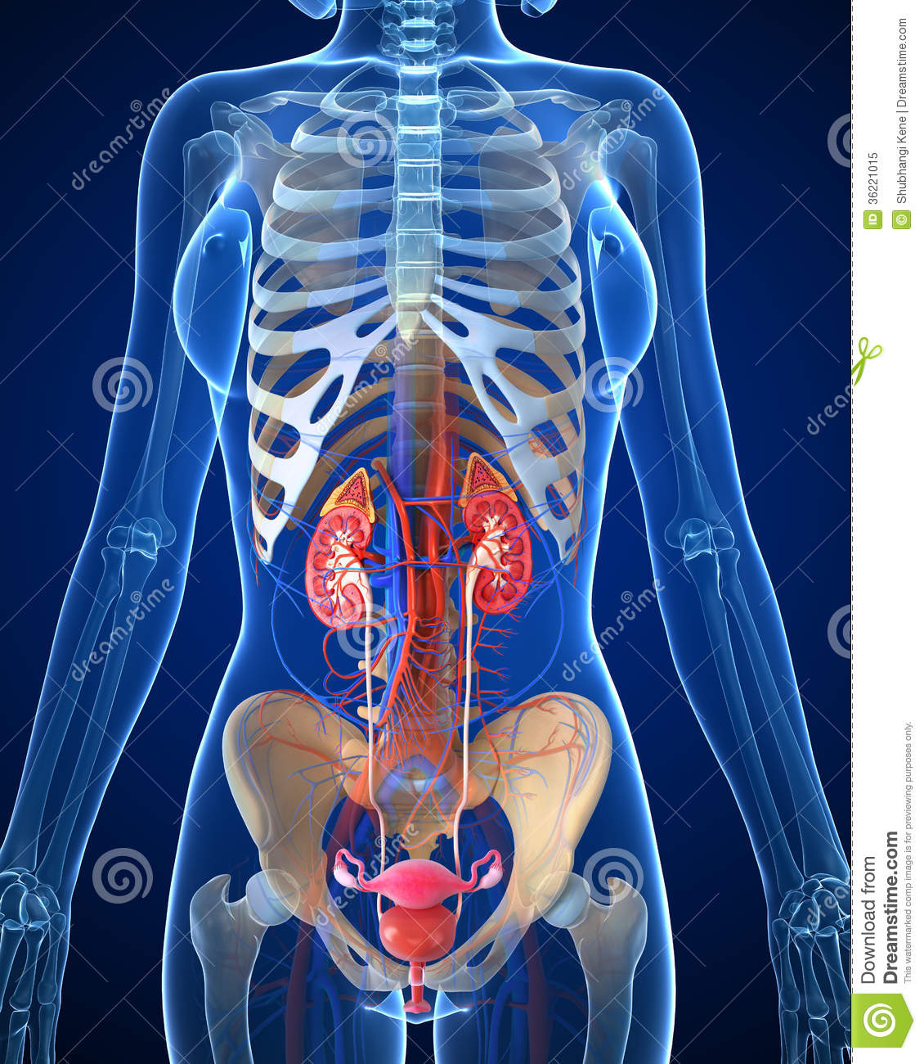
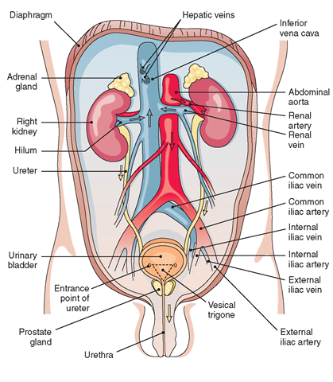
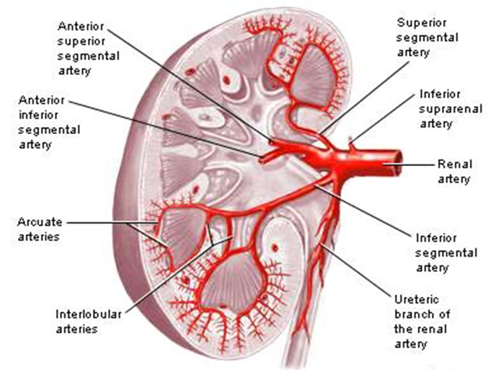
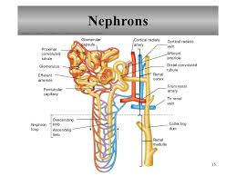
Urinary System
Filters
Eliminates
Reabsorbs
Controls fluid levels
Controls blood pressure
Pathophysiology
Cystitis
Kidney stones
Renal diseases
Specialist
urologist

Slide 16
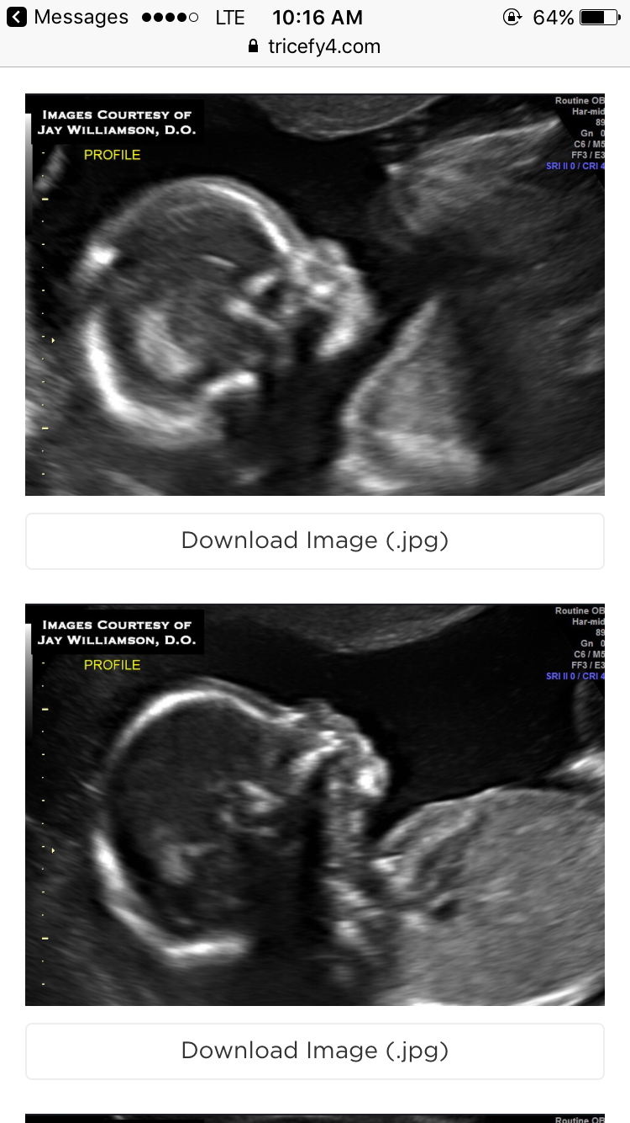
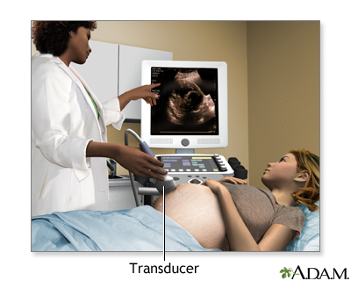
Reproductive system
Procreation
Pathophysiology
Cancer
STDs
Specialist
OBGYN
Urologist
Ultra sonographers

Slide 17
Properly use the terms that describe relative positons, body sections and body regions
Directions
Plains
Cavities
Regions
Quadrants
Extremities
Dental directional terms
Animal directional terms

Slide 18
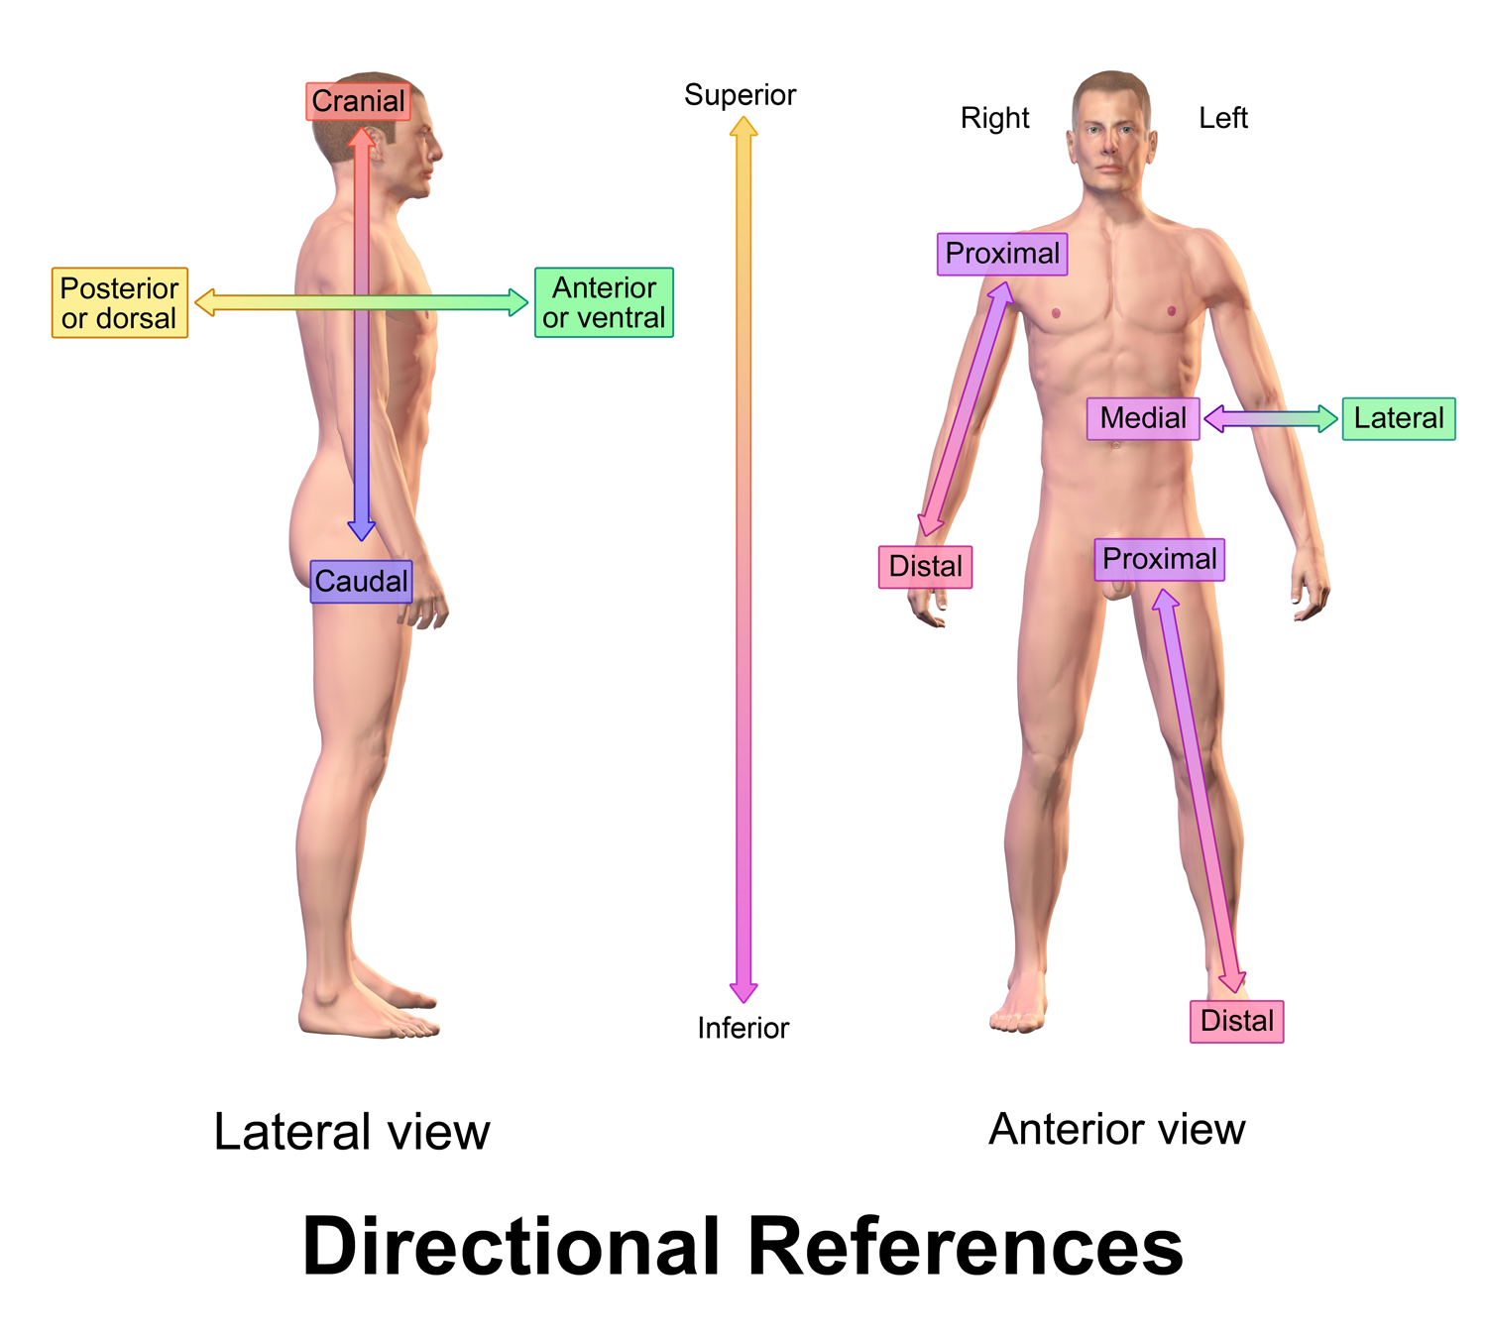
Directions
Superior (cranial) above –Inferior (caudal) below
Anterior (ventral) front- Posterior (dorsal) back
Medial toward midline- lateral away from midline
Proximal toward the center of the body- distal away from center of the body

Slide 19
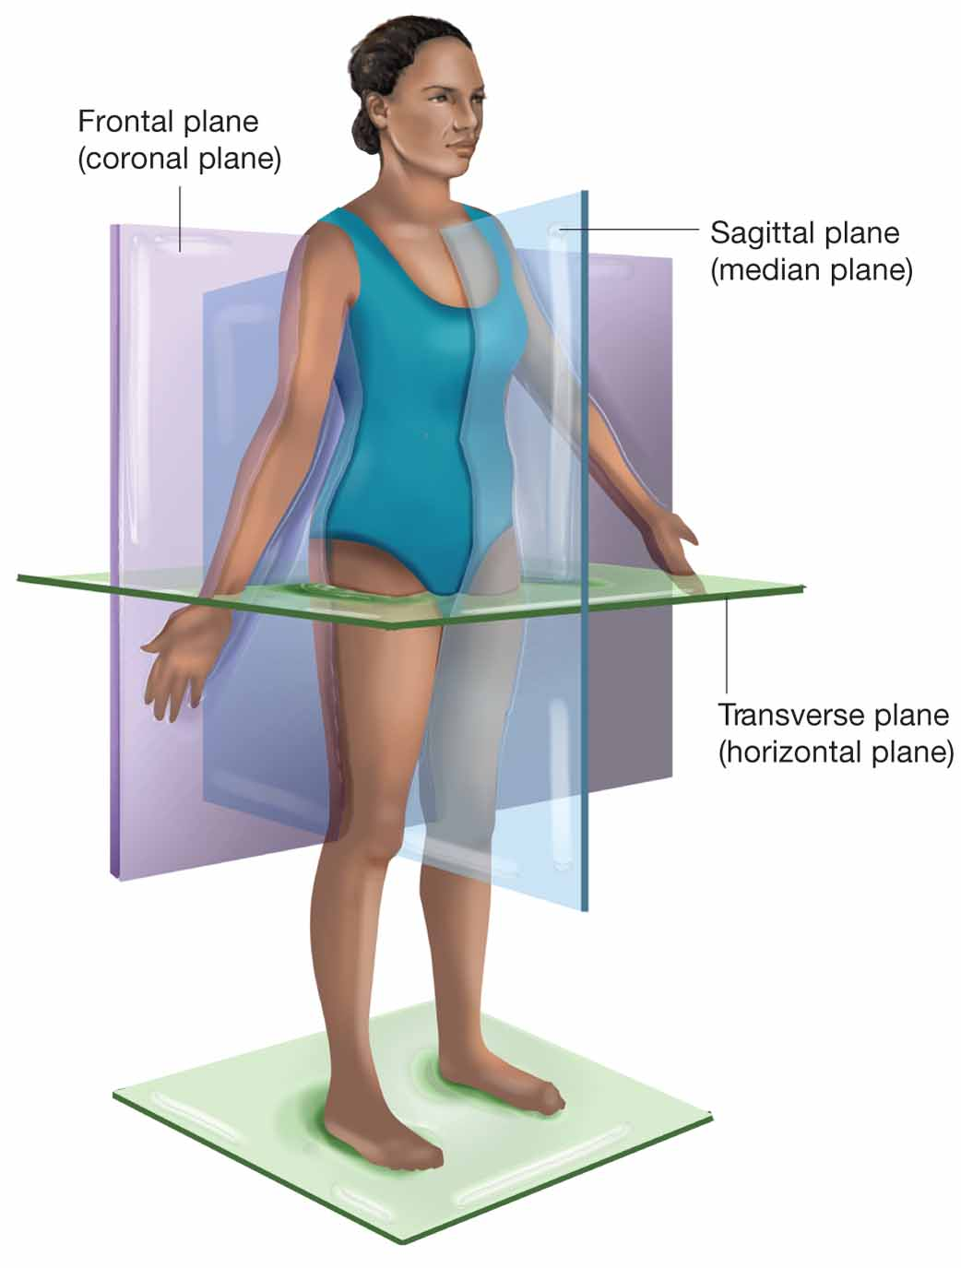
Planes
Transverse (Horizontal) divides superior and inferior
Frontal (Coronal) divides anterior and posterior
Sagittal divides the body in half at midline

Slide 20
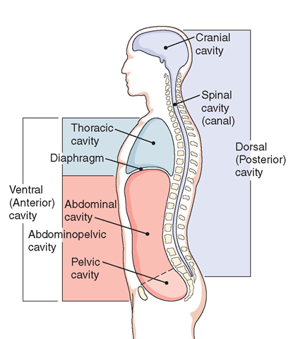
Cavities
Ventral cavities-
Thoracic
Abdominal
Pelvic
Dorsal cavities-
Cranial
Spinal

Slide 21
Regions

Slide 22
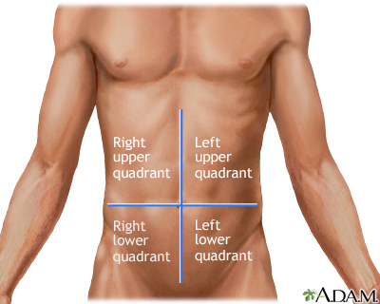
Quadrants
RUQ LUQ
RLQ LLQ

Slide 23
Animal planes

Slide 24
teeth directional terms

Slide 25
Describe the functions of the human body and explain how these functions aid in the maintenance of life
Metabolism
All chemical reactions needed to sustain life
Digestive and respiratory systems
Fluid and Electrolyte balance
Fluids and electrolytes must be in the compartments they are meant to be in for the body to work, and be free to move as needed in and out the intracellular extracellular spaces
We are %75 fluids
Important to maintain balance so the concentration of water and electrolytes is within normal limits
If fluids are out of balance illness occurs
Circulatory, urinary, and lymphatic systems all involved
Homeostasis

Slide 26
Develop an understanding of homeostasis and its role in normal body function
Homeostasis is the
Steady state of body conditions
Staying the same even when external conditions change
Integumentary, nervous, endocrine, circulatory, immune system
Examples
BP
Temp
Cell concentration
Blood sugar levels
Blood concentration

